Slide 1
Android Multimedia
Framework Overview
By Venkata Rao

Slide 2
Agenda
What is Multimedia in a mobile device
Android Multimedia Framework
–OpenCORE
–OpenMAX
–Stgefright
–Meadia Player service
–MPEG standard
–File format
–Codec
–What we can do with this

Slide 3
What is Multimedia in mobile device
Multimedia is the most important component in modern mobile device
–Multimedia framework is used to process video/audio input and output to satisfy certain functionality including
Video and Audio :
–Storage video and audio in media
–Playback video and audio
–Record video and audio

Slide 4
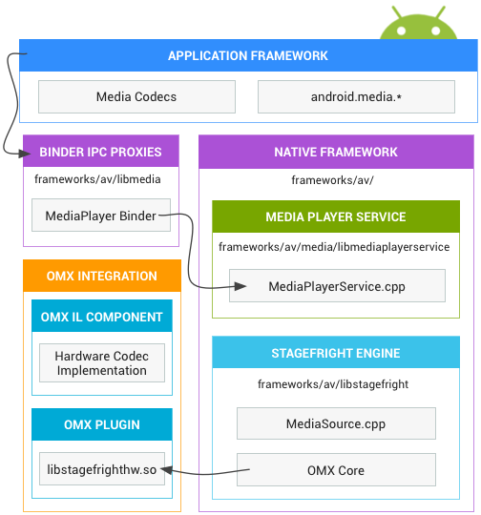
Media framework architechture

Slide 5
Application Framework
At the application framework level is application code that utilizes android.media APIs to interact with the multimedia hardware.
MediaCodec class can be used to access low-level media codecs, i.e. encoder/decoder components.
It is part of the Android low-level multimedia support infrastructure
Notes:
h

Slide 6
Binder IPC Proxies
The Binder IPC proxies facilitate communication over process boundaries.
Synchronous communication b/w processes
They are located in the frameworks/av/media/libmedia directory and begin with the letter "I".

Slide 7
Native Framework
At the native level, Android provides a multimedia framework that utilizes the Stagefright engine for audio and video recording and playback.
Stagefright :

Slide 8
Stagefright
Stagefright comes with a default list of supported software codecs and you can implement your own hardware codec by using the OpenMax integration layer standard.
For more implementation details, see the MediaPlayer and Stagefright components located in frameworks/av/media.

Slide 10
OMX Integration

Slide 11
Codec/Decode

Slide 14
File Formates

